Slide 1
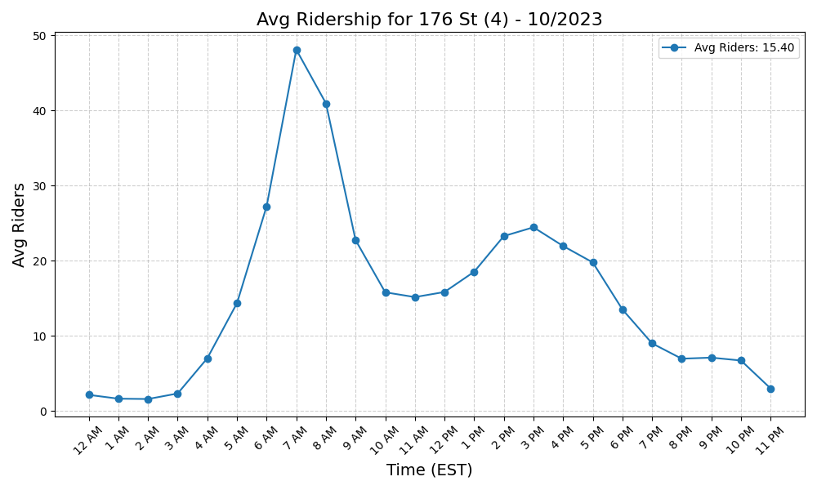
176 St (4) - 10/2023

Slide 2

167 St (4) - 10/2023

Slide 3
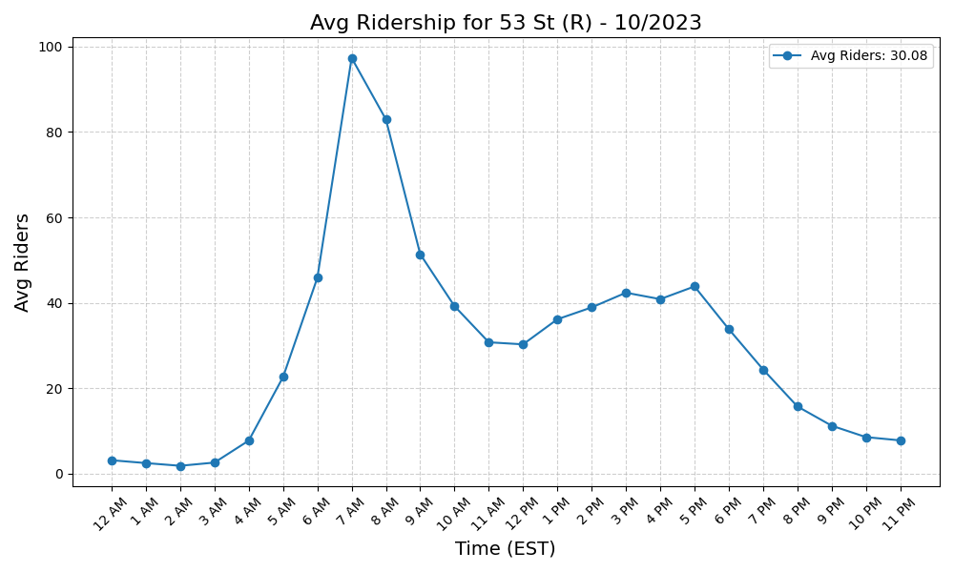
53 St (R) - 10/2023

Slide 4
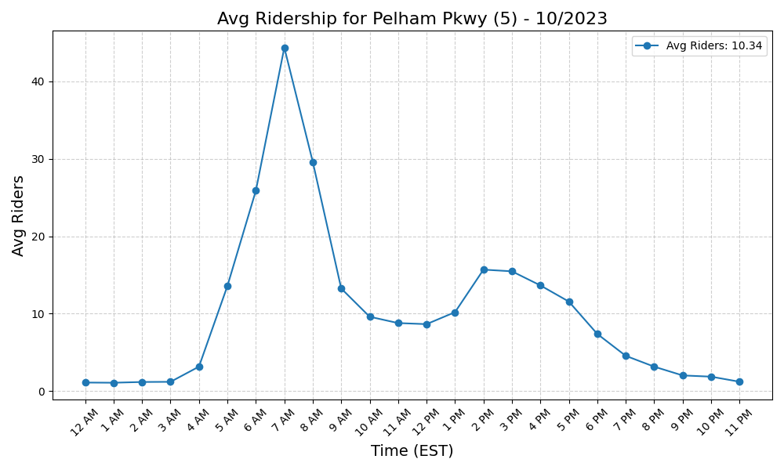
Pelham Pkwy (5) - 10/2023

Slide 5
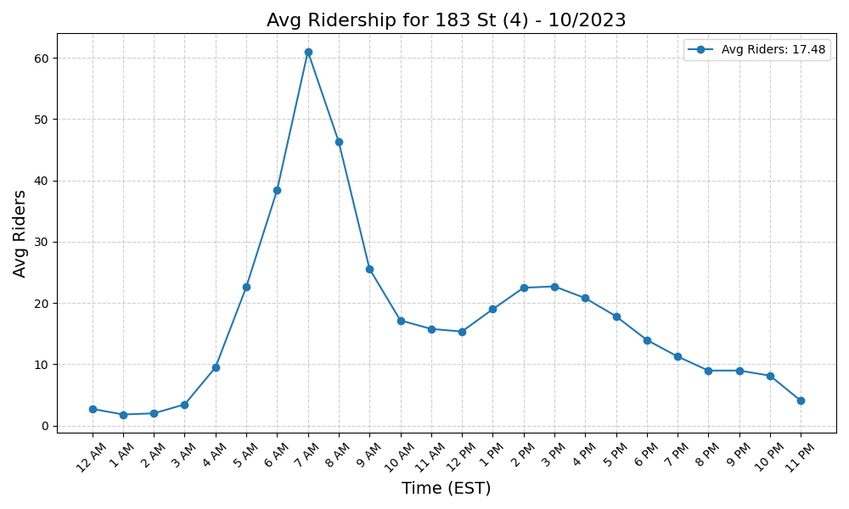
183 St (4) - 10/2023

Slide 6
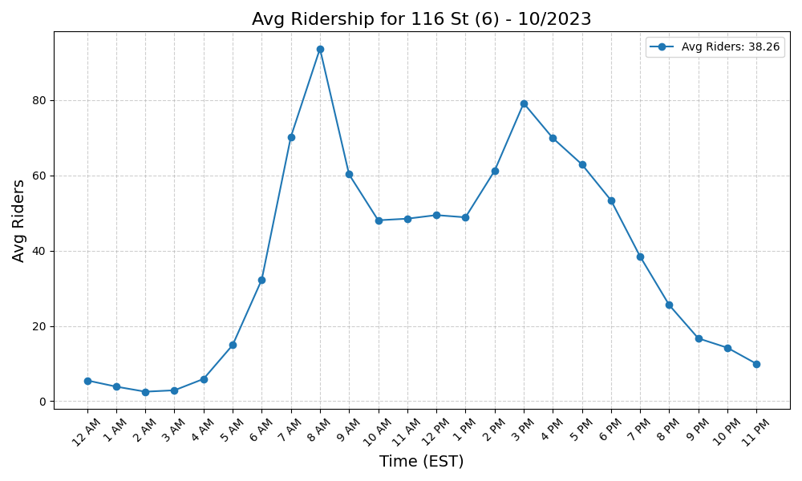
116 St (6) - 10/2023

Slide 7
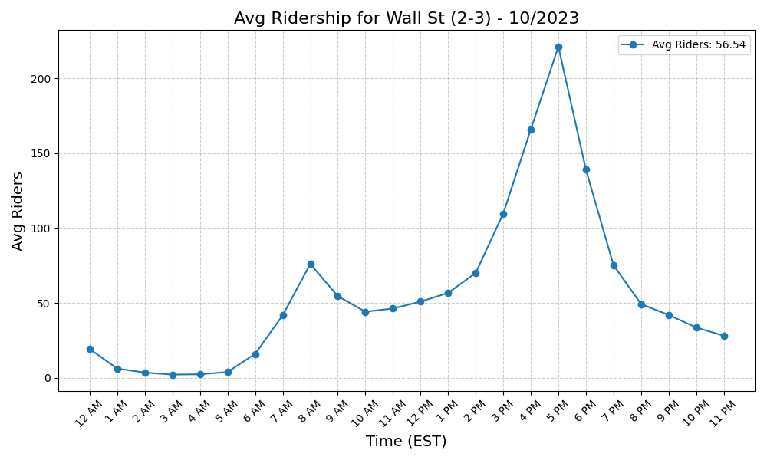
Wall St (2-3) - 10/2023

Slide 8
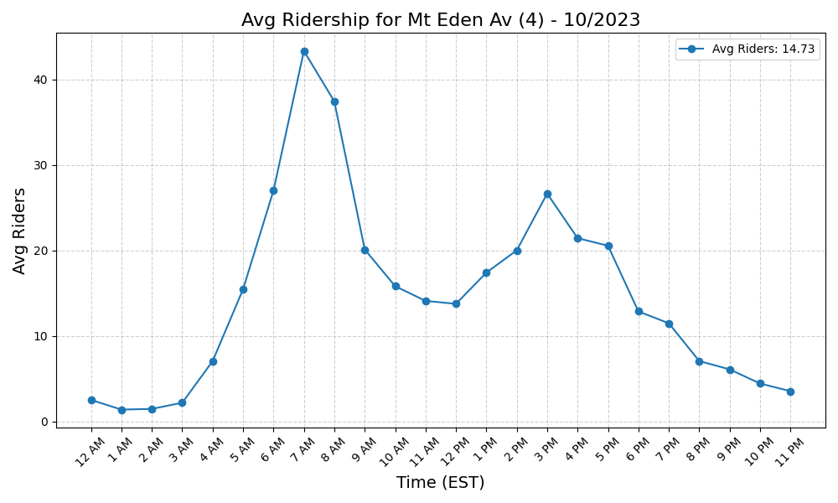
Mt Eden Av (4) - 10/2023

Slide 9
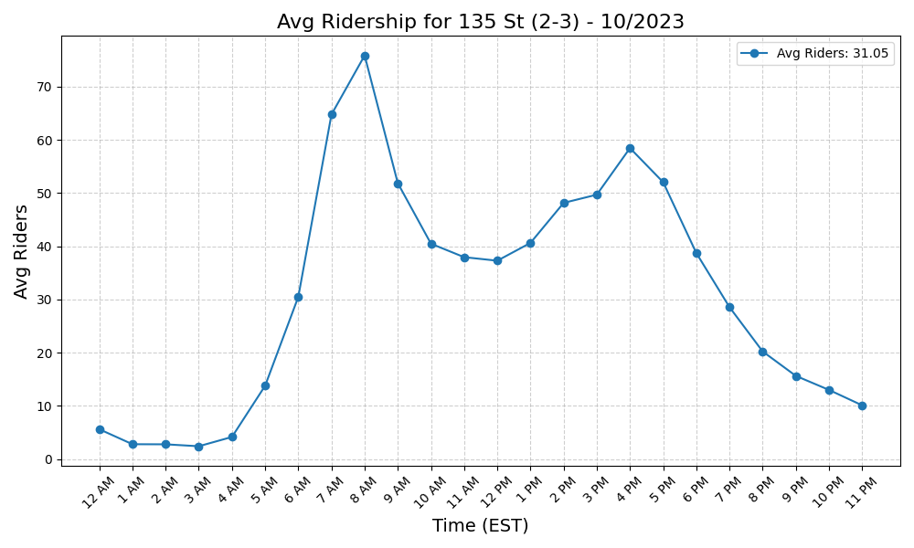
135 St (2-3) - 10/2023

Slide 10
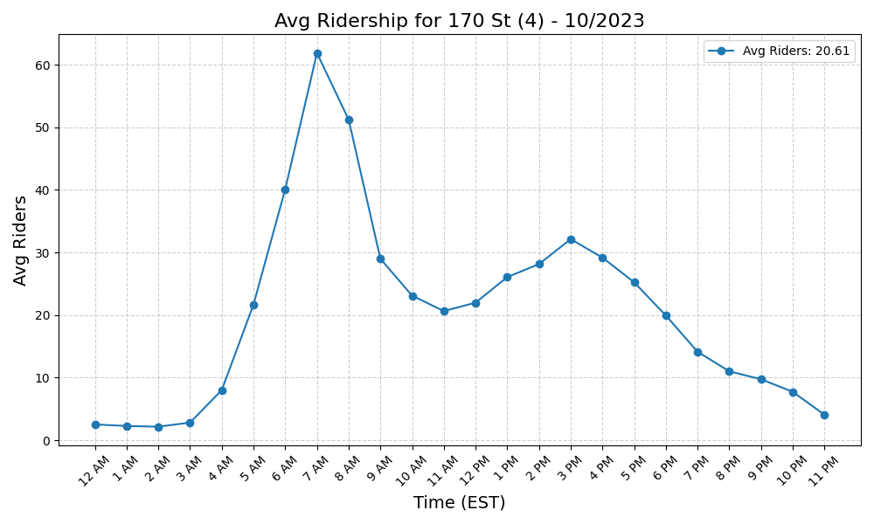
170 St (4) - 10/2023

Slide 11

Gun Hill Rd (5) - 10/2023

Slide 12
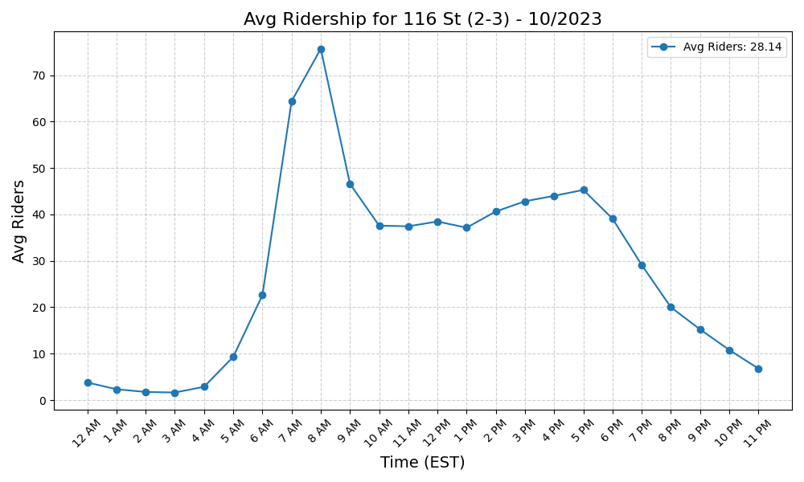
116 St (2-3) - 10/2023

Slide 13
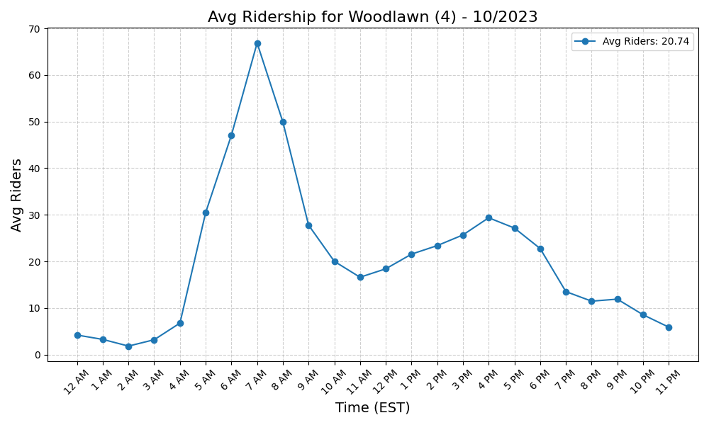
Woodlawn (4) - 10/2023

Slide 14
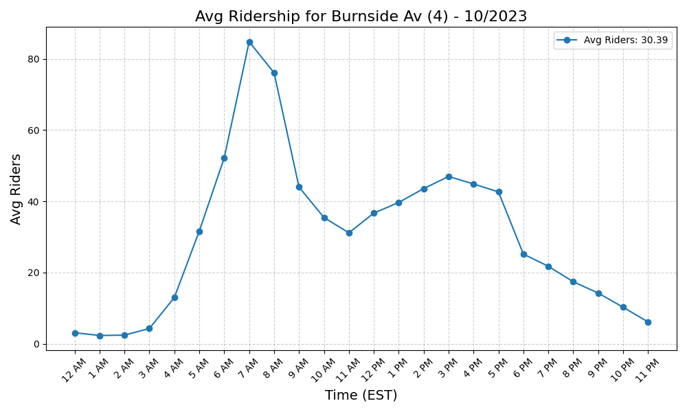
Burnside Av (4) - 10/2023

Slide 15
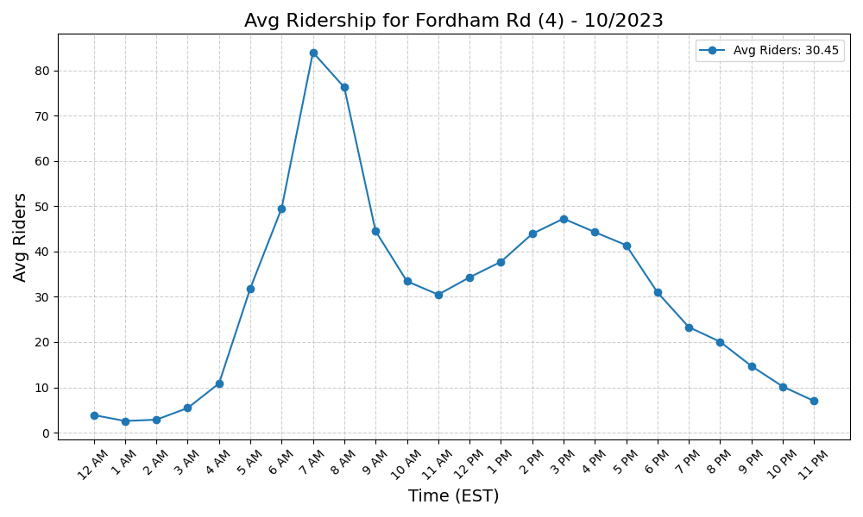
Fordham Rd (4) - 10/2023

Slide 16
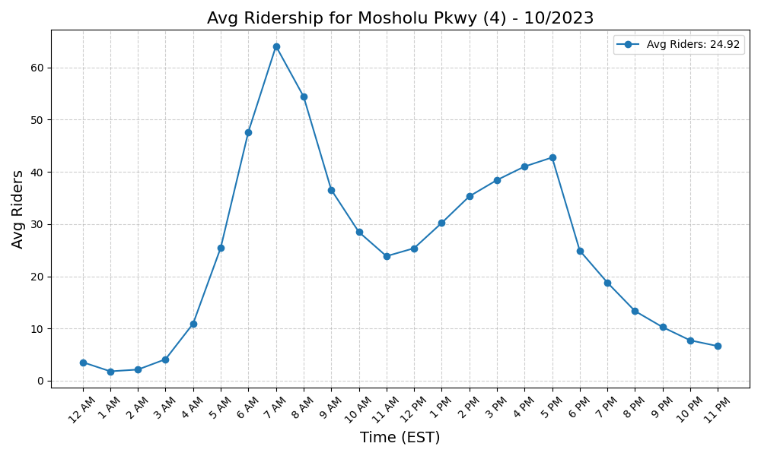
Mosholu Pkwy (4) - 10/2023

Slide 17

Hoyt St (2-3) - 10/2023

Slide 18
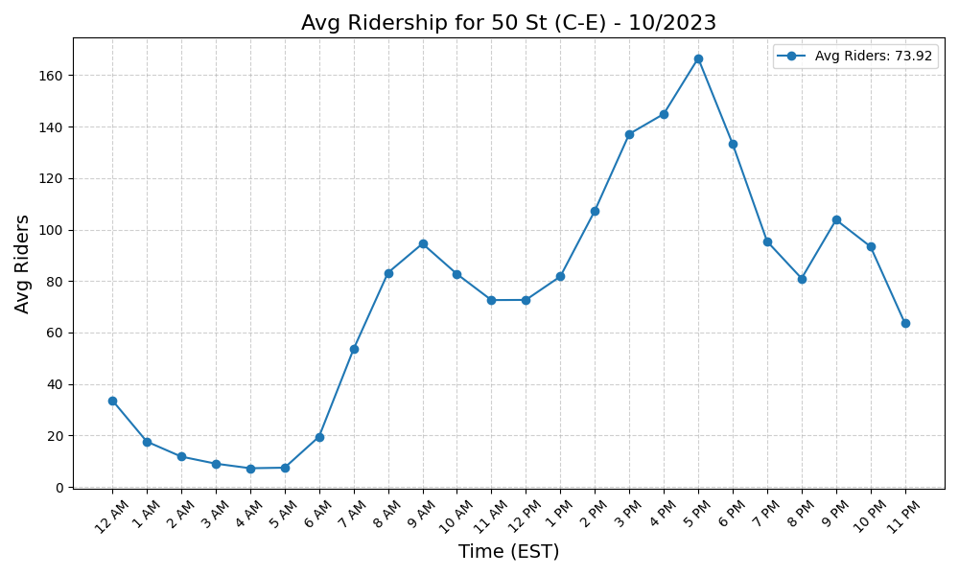
50 St (C-E) - 10/2023

Slide 19
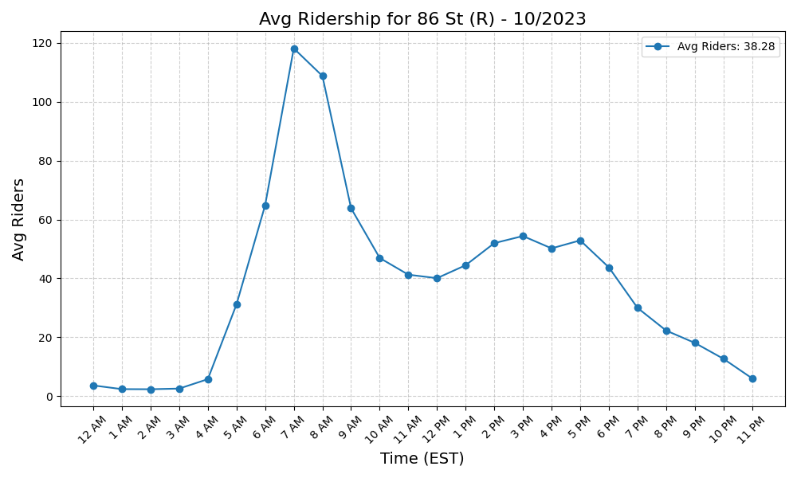
86 St (R) - 10/2023

Slide 20
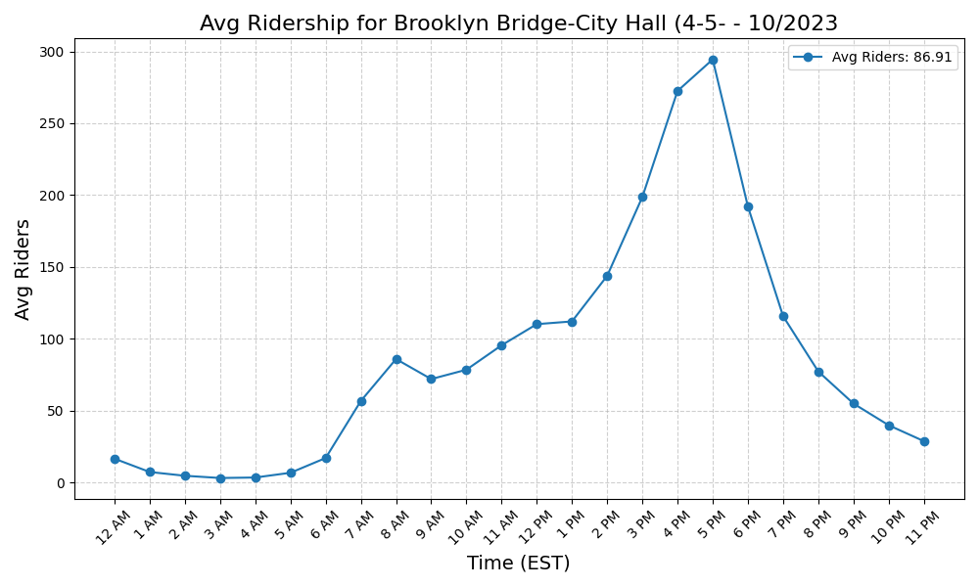
Brooklyn Bridge-City Hall (4-5- - 10/2023

Slide 21
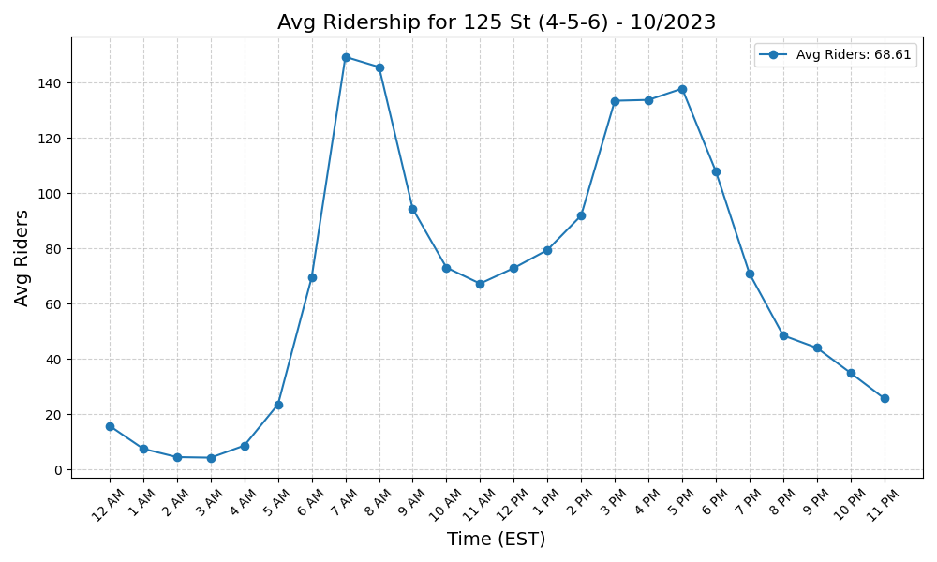
125 St (4-5-6) - 10/2023

Slide 22
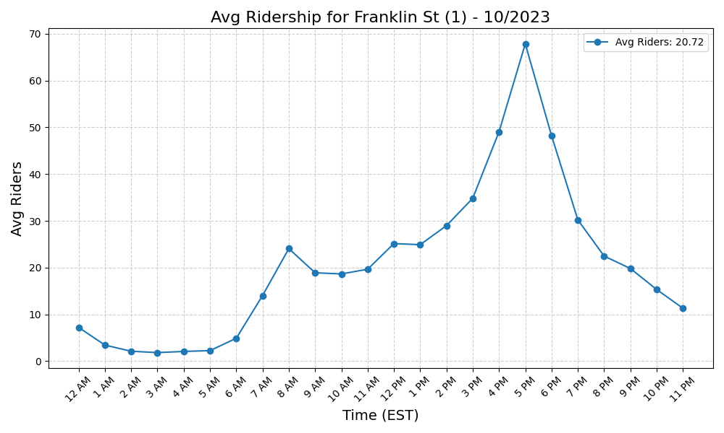
Franklin St (1) - 10/2023

Slide 23
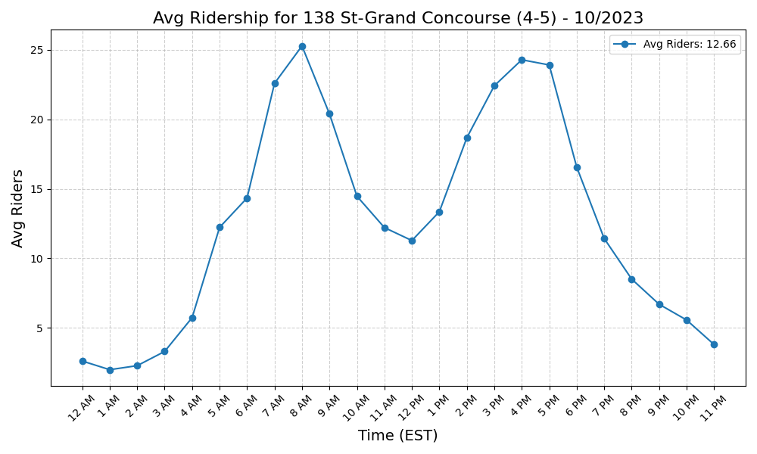
138 St-Grand Concourse (4-5) - 10/2023

Slide 24
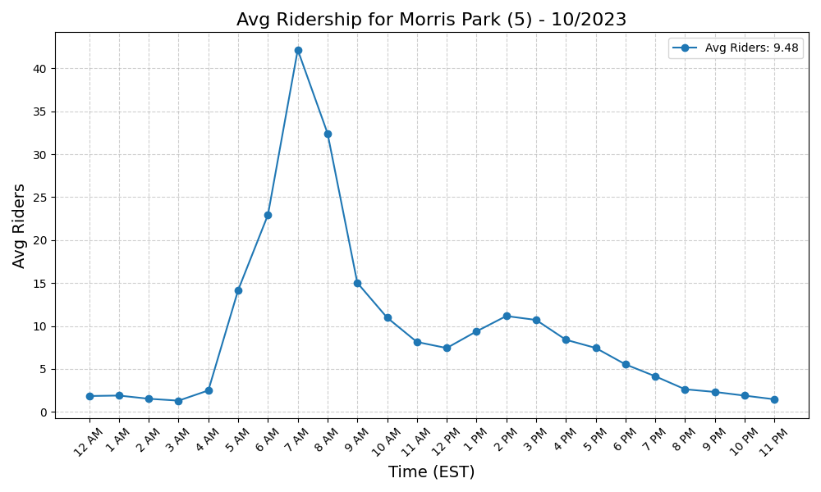
Morris Park (5) - 10/2023

Slide 25
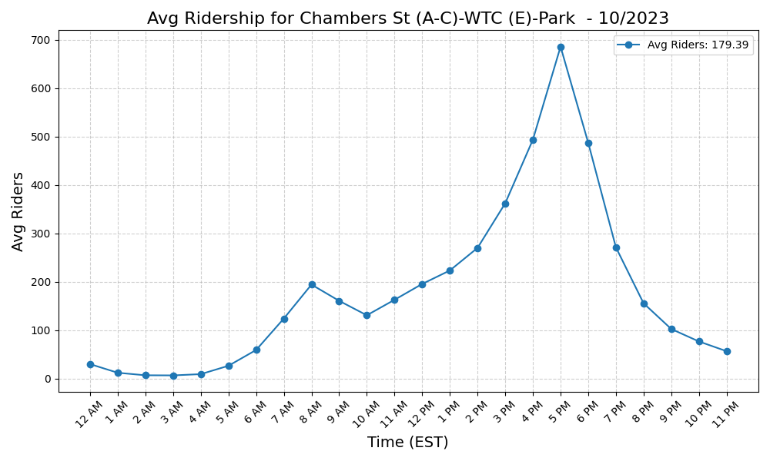
Chambers St (A-C)-WTC (E)-Park - 10/2023

Slide 26
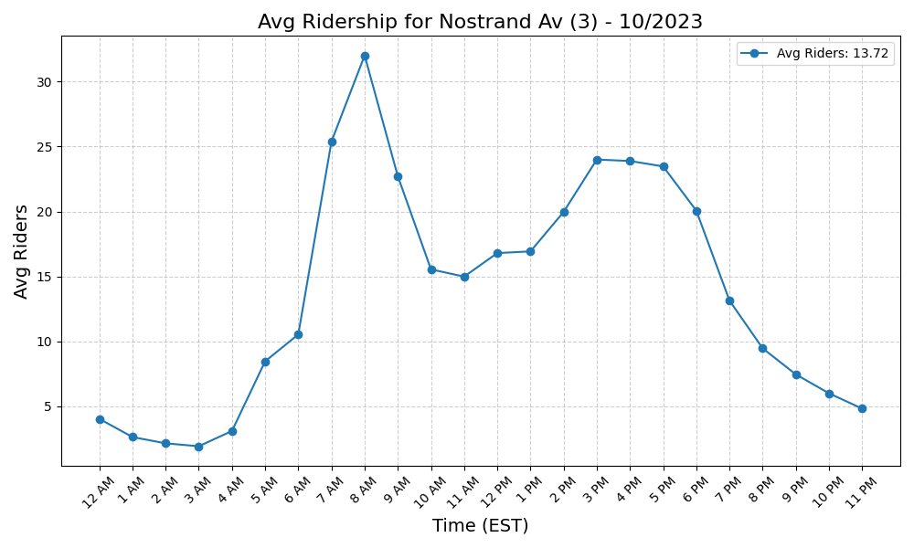
Nostrand Av (3) - 10/2023

Slide 27
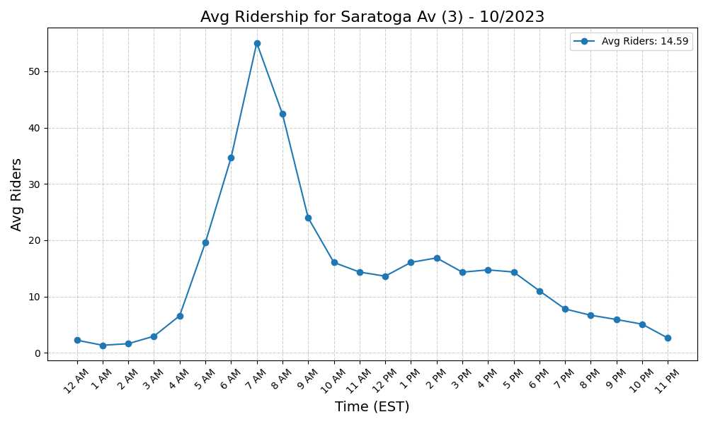
Saratoga Av (3) - 10/2023

Slide 28
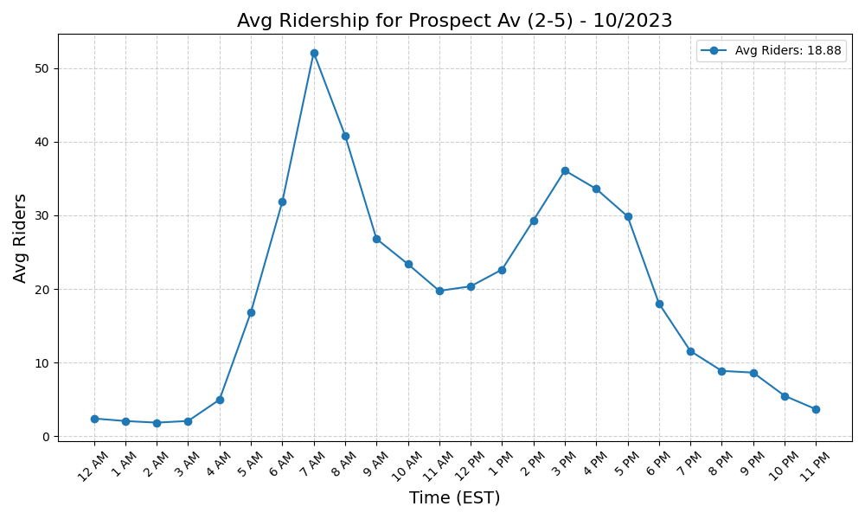
Prospect Av (2-5) - 10/2023

Slide 29
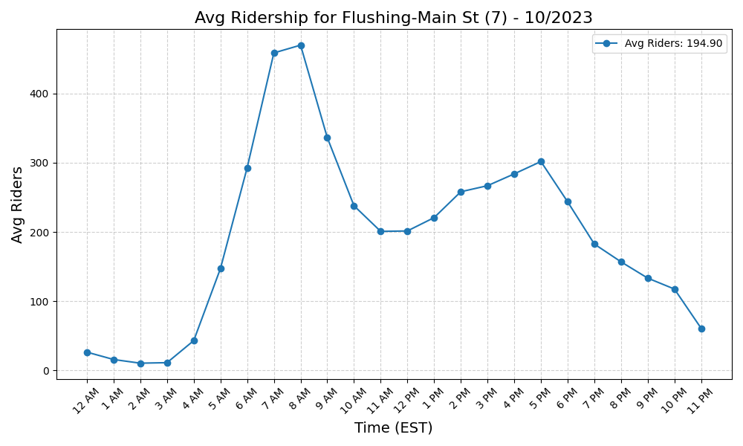
Flushing-Main St (7) - 10/2023

Slide 30
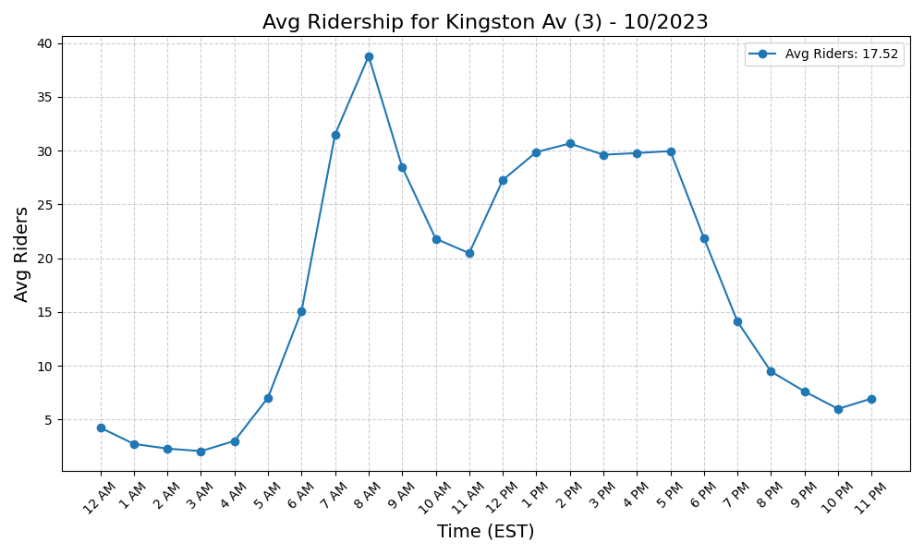
Kingston Av (3) - 10/2023

Slide 31
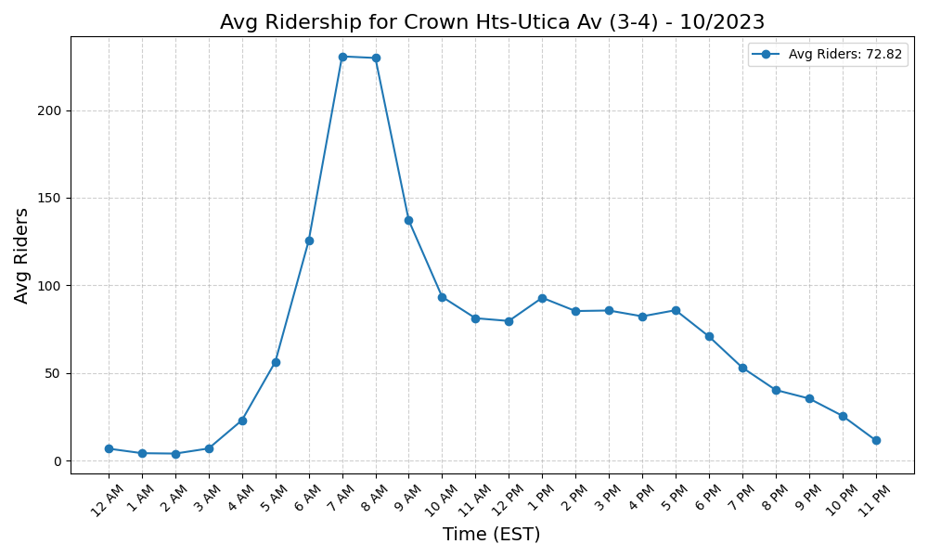
Crown Hts-Utica Av (3-4) - 10/2023

Slide 32
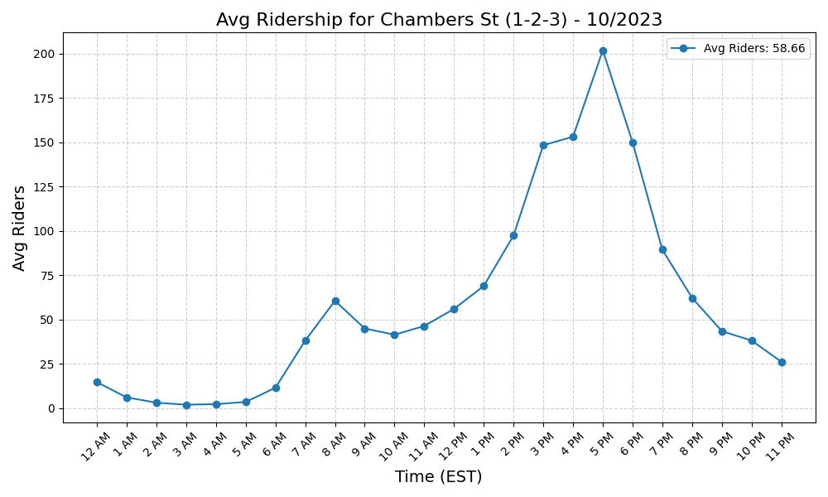
Chambers St (1-2-3) - 10/2023

Slide 33
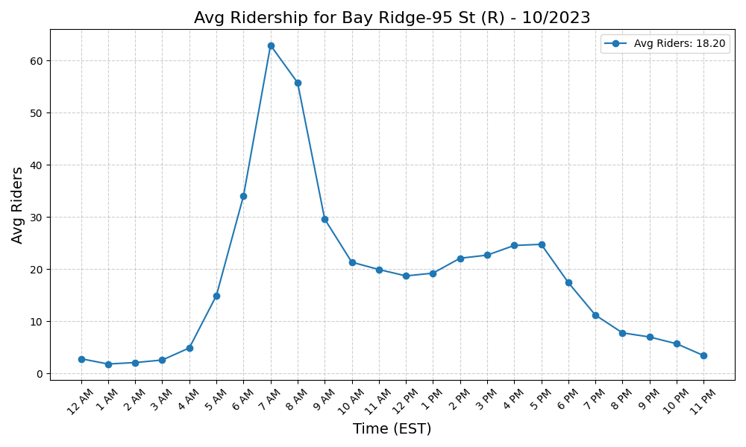
Bay Ridge-95 St (R) - 10/2023

Slide 34
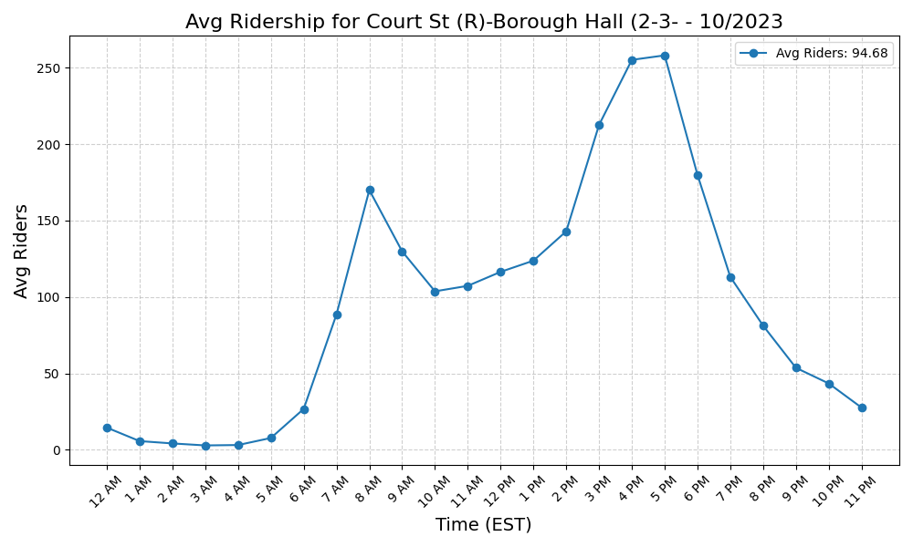
Court St (R)-Borough Hall (2-3- - 10/2023

Slide 35
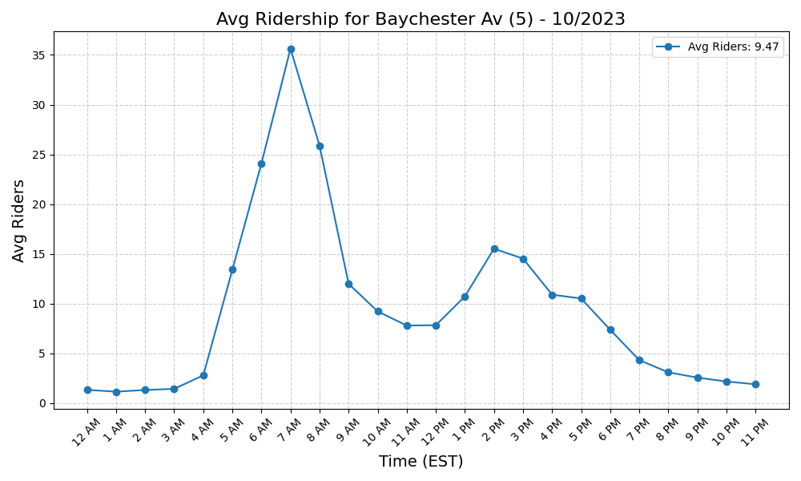
Baychester Av (5) - 10/2023

Slide 36
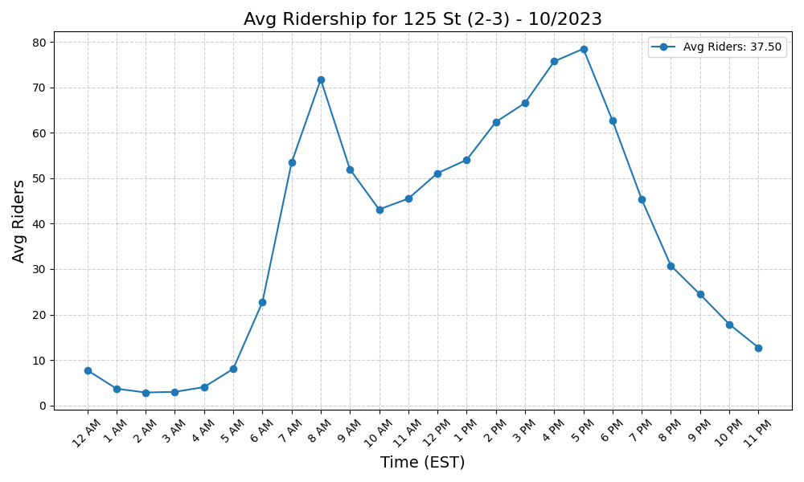
125 St (2-3) - 10/2023

Slide 37
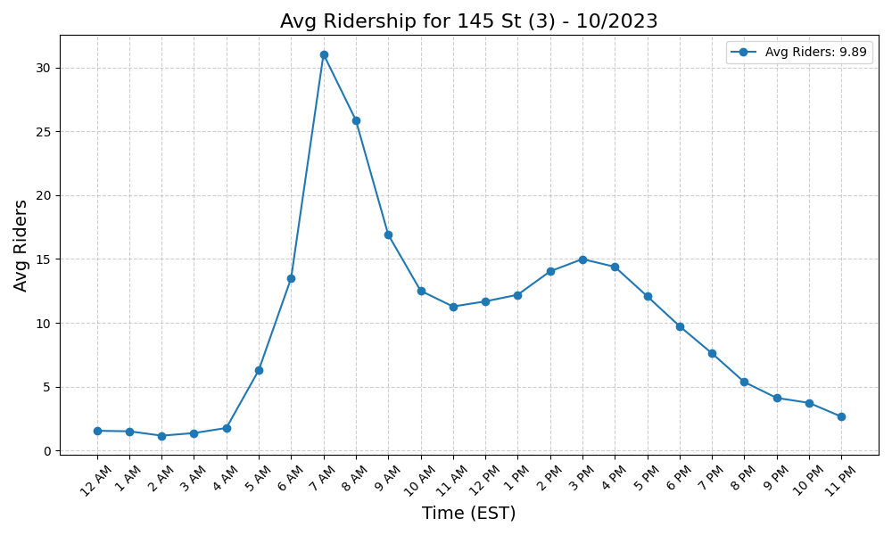
145 St (3) - 10/2023

Slide 38
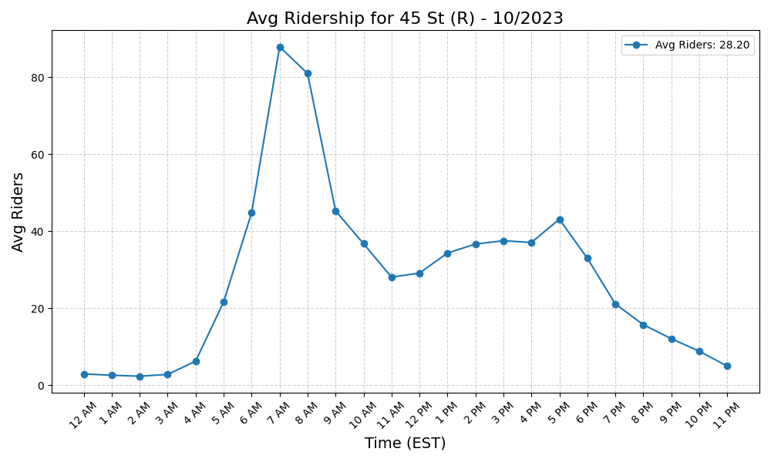
45 St (R) - 10/2023

Slide 39
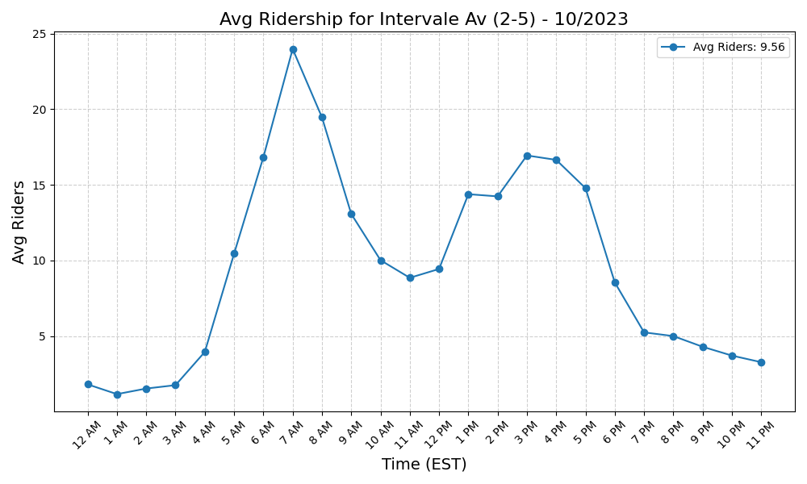
Intervale Av (2-5) - 10/2023

Slide 40
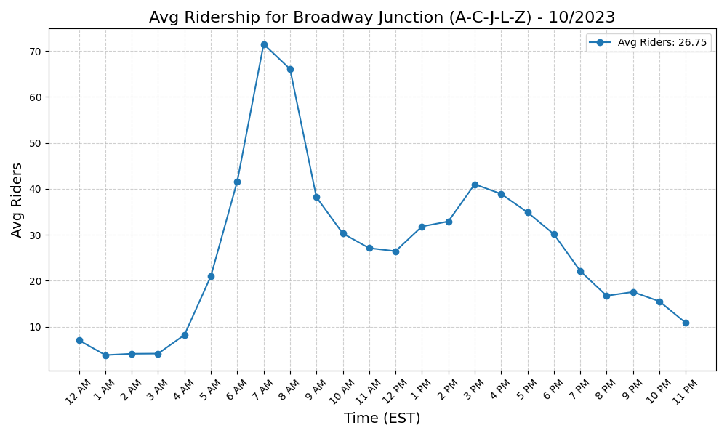
Broadway Junction (A-C-J-L-Z) - 10/2023

Slide 41
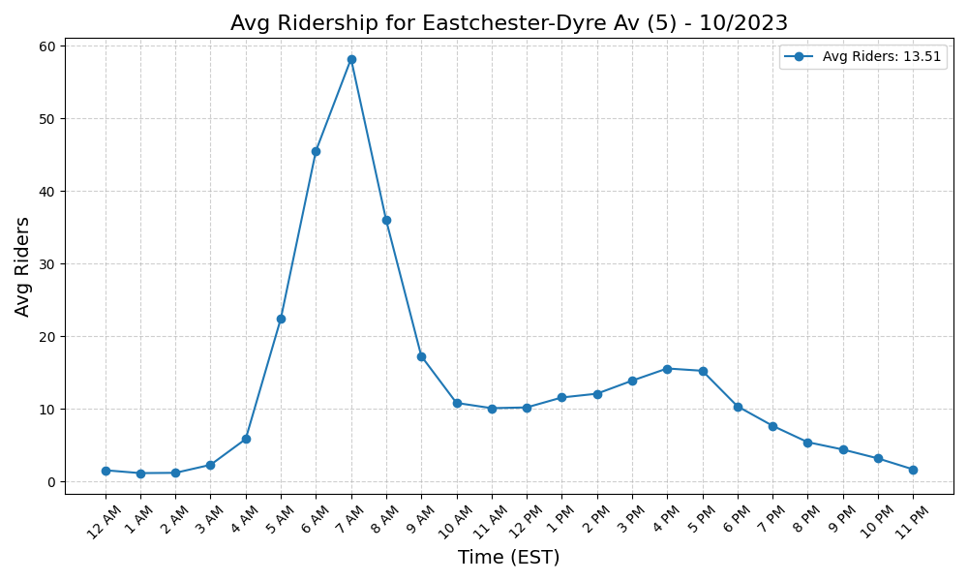
Eastchester-Dyre Av (5) - 10/2023

Slide 42
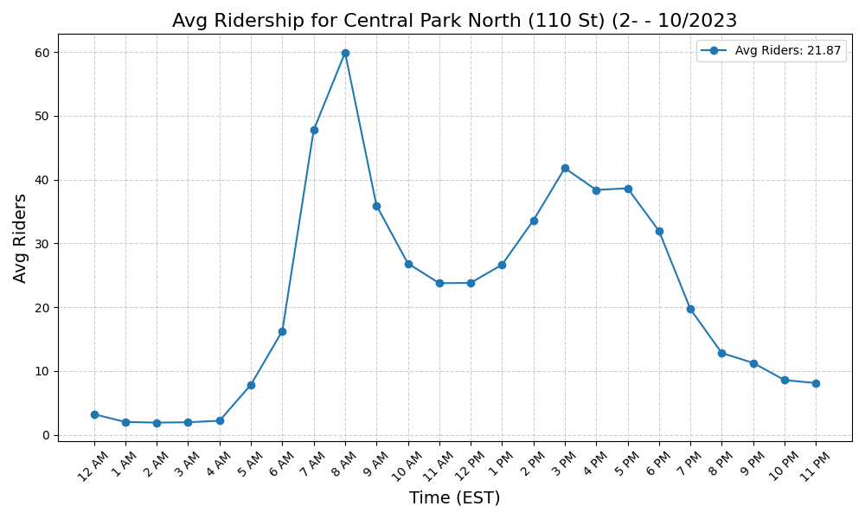
Central Park North (110 St) (2- - 10/2023

Slide 43
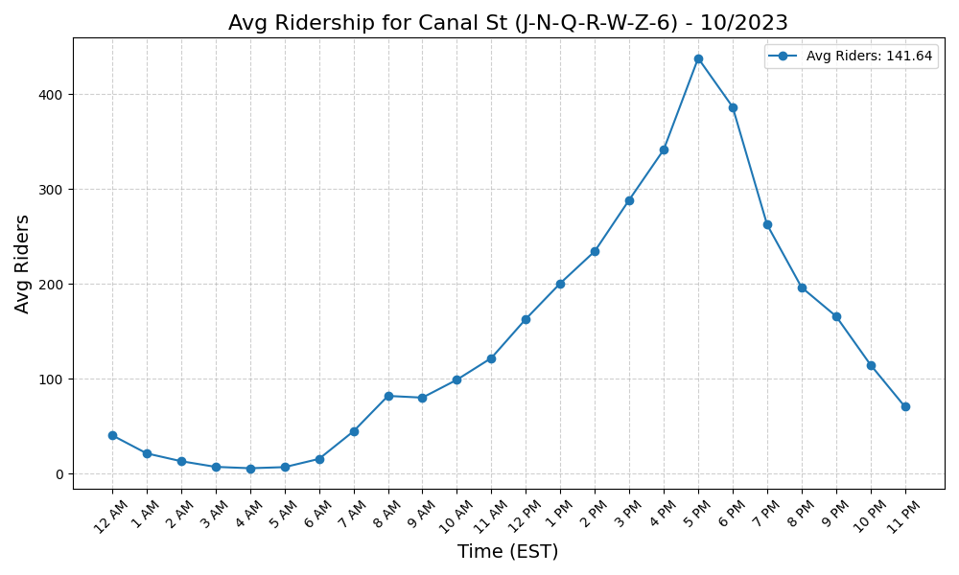
Canal St (J-N-Q-R-W-Z-6) - 10/2023

Slide 44
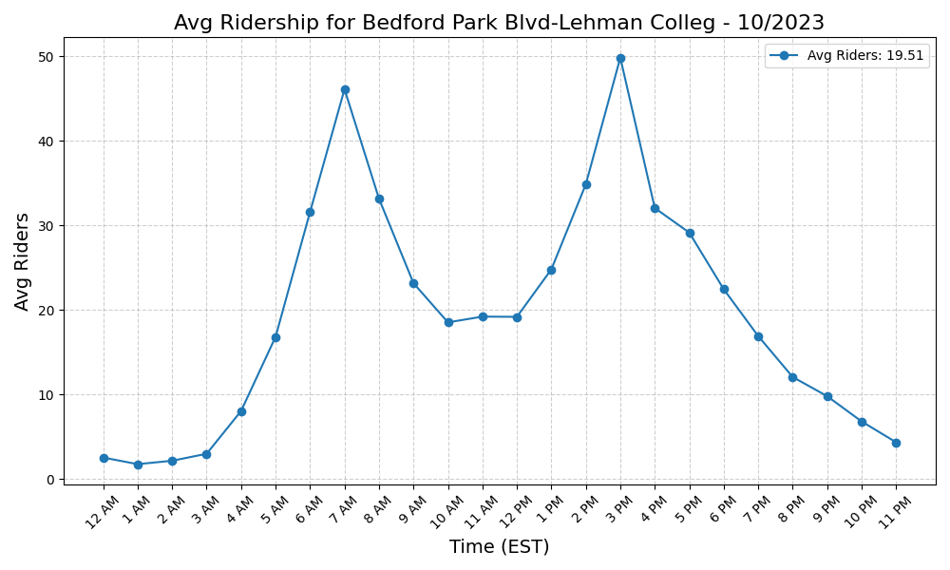
Bedford Park Blvd-Lehman Colleg - 10/2023

Slide 45
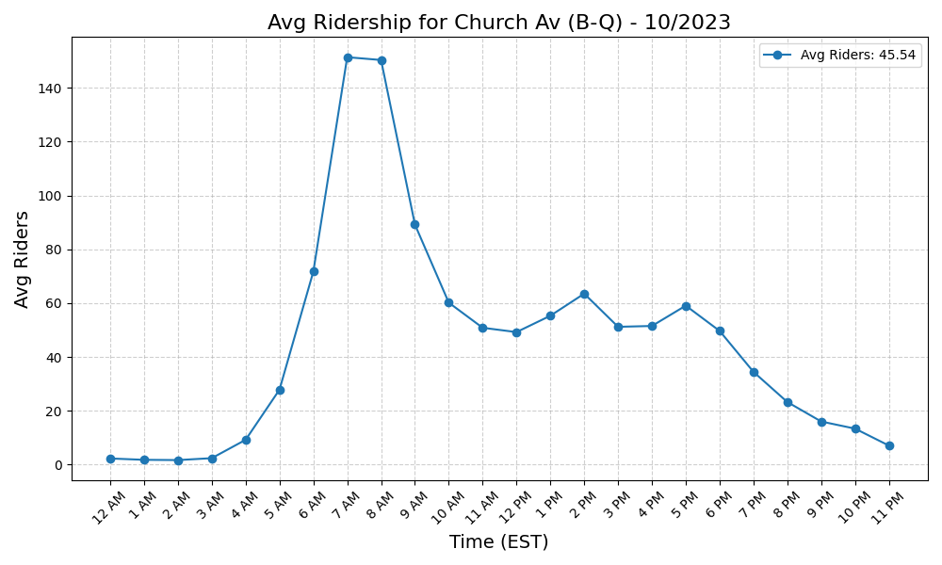
Church Av (B-Q) - 10/2023

Slide 46
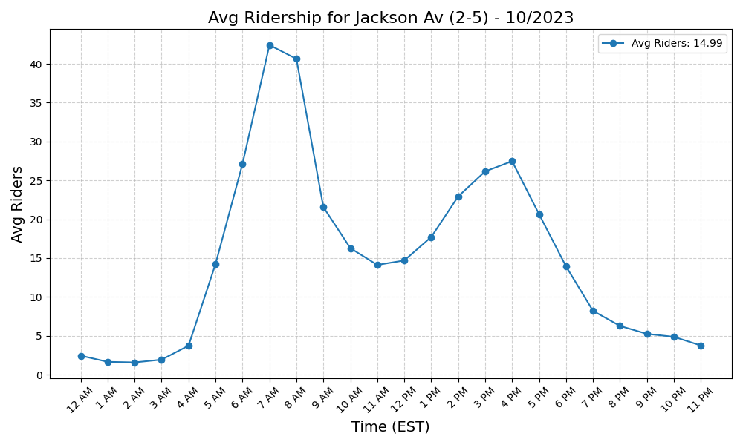
Jackson Av (2-5) - 10/2023

Slide 47
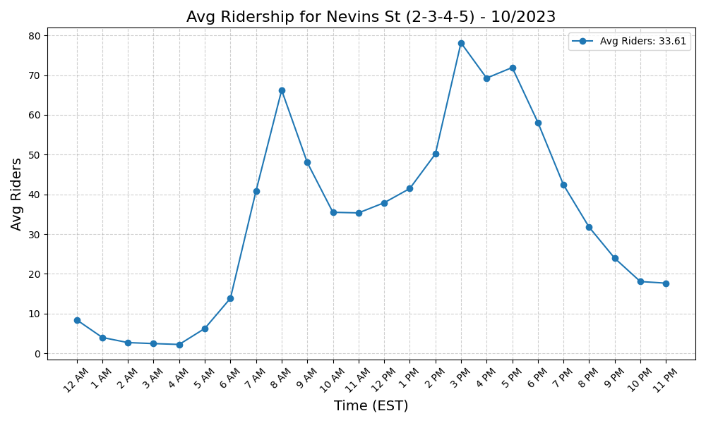
Nevins St (2-3-4-5) - 10/2023

Slide 48
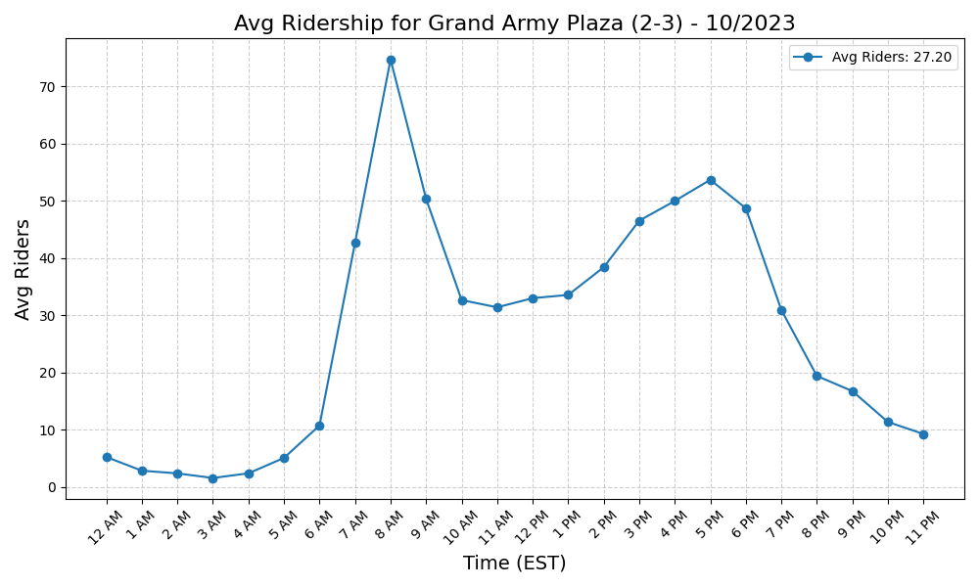
Grand Army Plaza (2-3) - 10/2023

Slide 49
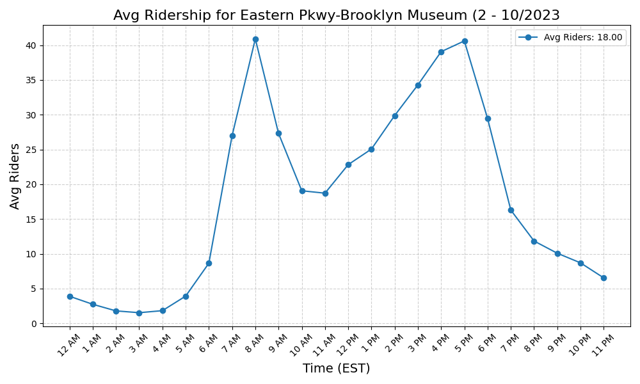
Eastern Pkwy-Brooklyn Museum (2 - 10/2023

Slide 50
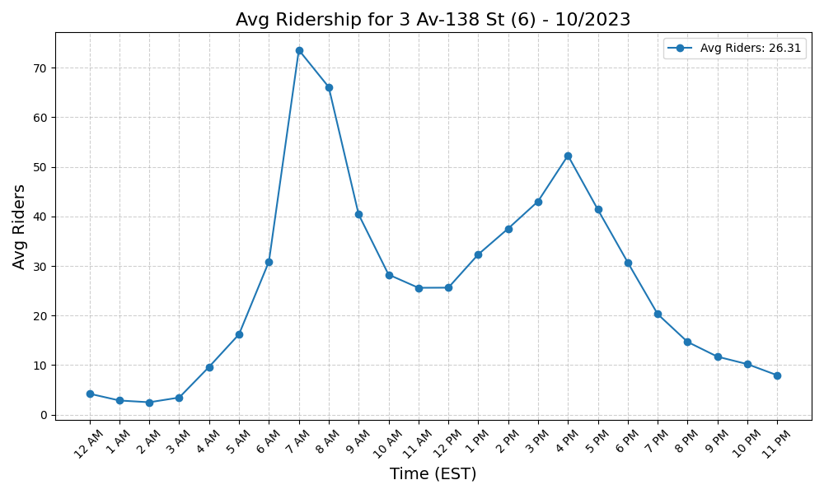
3 Av-138 St (6) - 10/2023

Slide 51
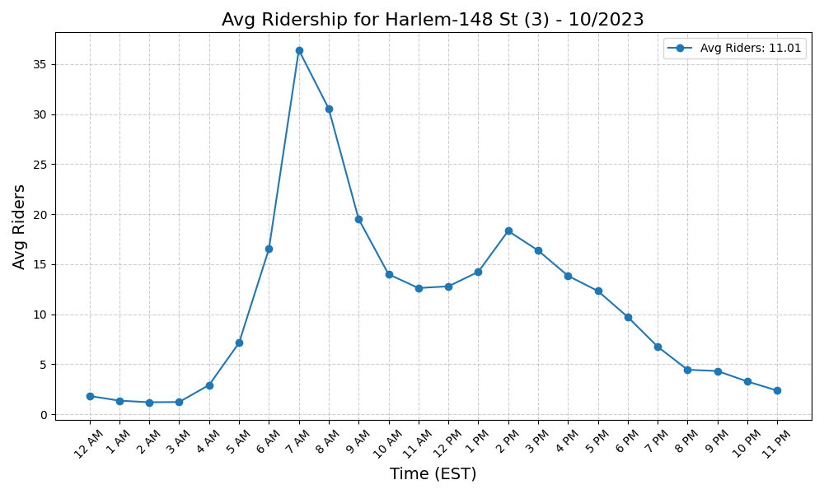
Harlem-148 St (3) - 10/2023

Slide 52
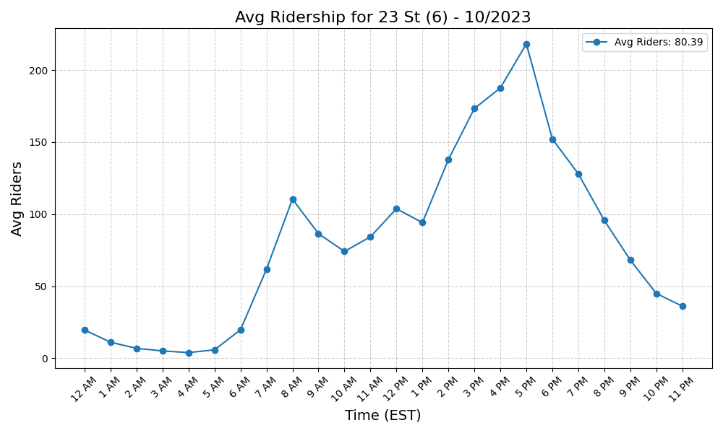
23 St (6) - 10/2023

Slide 53
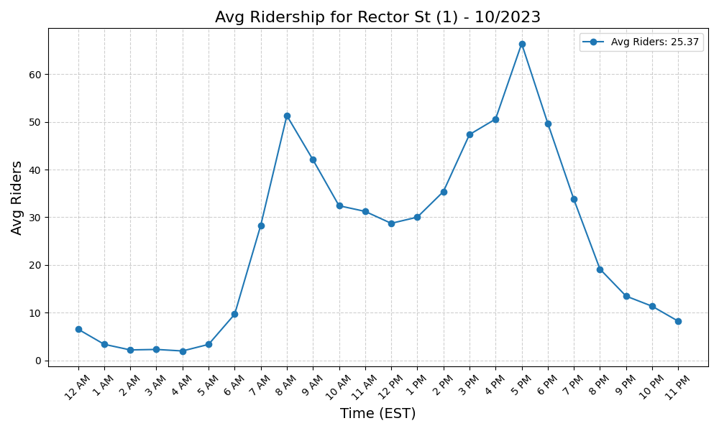
Rector St (1) - 10/2023

Slide 54

3 Av-149 St (2-5) - 10/2023

Slide 55

Sutter Av-Rutland Rd (3) - 10/2023

Slide 56

WTC Cortlandt (1) - 10/2023

Slide 57

Kingsbridge Rd (4) - 10/2023

Slide 58

Mets-Willets Point (7) - 10/2023

Slide 59

Clark St (2-3) - 10/2023

Slide 60

Bergen St (2-3) - 10/2023

Slide 61

135 St (C-B) - 10/2023

Slide 62

96 St (6) - 10/2023

Slide 63

86 St (C-B) - 10/2023

Slide 64

Beach 36 St (A) - 10/2023

Slide 65

Beach 67 St (A) - 10/2023

Slide 66

71 St (D) - 10/2023

Slide 67

59 St (N-R) - 10/2023

Slide 68

46 St (M-R) - 10/2023

Slide 69

52 St (7) - 10/2023

Slide 70

190 St (A) - 10/2023

Slide 71

36 St (M-R) - 10/2023

Slide 72

Fordham Rd (B-D) - 10/2023

Slide 73

77 St (6) - 10/2023

Slide 74

7 Av (B-Q) - 10/2023

Slide 75

Beach 60 St (A) - 10/2023

Slide 76

Halsey St (L) - 10/2023

Slide 77

DeKalb Av (L) - 10/2023

Slide 78

Buhre Av (6) - 10/2023

Slide 79

169 St (F) - 10/2023

Slide 80

18 St (1) - 10/2023

Slide 81

Grand St (L) - 10/2023

Slide 82

Central Av (M) - 10/2023

Slide 83

Ralph Av (C) - 10/2023

Slide 84

Canal St (1) - 10/2023

Slide 85

Gates Av (J-Z) - 10/2023

Slide 86

18 Av (F) - 10/2023

Slide 87

79 St (1) - 10/2023

Slide 88

49 St (N-R-W) - 10/2023

Slide 89

23 St (R-W) - 10/2023

Slide 90

3 Av (L) - 10/2023

Slide 91

Halsey St (J) - 10/2023

Slide 92

36 St (D-N-R) - 10/2023

Slide 93

Forest Av (M) - 10/2023

Slide 94

28 St (R-W) - 10/2023

Slide 95

50 St (1) - 10/2023

Slide 96

Avenue U (F) - 10/2023

Slide 97

88 St (A) - 10/2023

Slide 98

Grant Av (A) - 10/2023

Slide 99

Avenue I (F) - 10/2023

Slide 100

Alabama Av (J) - 10/2023

Slide 101

90 St-Elmhurst Av (7) - 10/2023

Slide 102

Rockaway Av (3) - 10/2023

Slide 103

Fulton St (A-C-J-Z-2-3-4-5) - 10/2023

Slide 104

103 St-Corona Plaza (7) - 10/2023

Slide 105

DeKalb Av (B-Q-R) - 10/2023

Slide 106

14 St (F-M-1-2-3)-6 Av (L) - 10/2023

Slide 107

Northern Blvd (M-R) - 10/2023

Slide 108

Kew Gardens-Union Tpke (E-F) - 10/2023

Slide 109

Lorimer St (L)-Metropolitan Av - 10/2023

Slide 110

Delancey St (F)-Essex St (J-M-Z - 10/2023

Slide 111

Briarwood (E-F) - 10/2023

Slide 112

Queensboro Plaza (7-N-W) - 10/2023

Slide 113

163 St-Amsterdam Av (C) - 10/2023

Slide 114

145 St (A-C-B-D) - 10/2023

Slide 115

8 St-NYU (R-W) - 10/2023

Slide 116

Coney Island-Stillwell Av (D-F- - 10/2023

Slide 117

149 St-Grand Concourse (2-4-5) - 10/2023

Slide 118

Bedford Park Blvd (B-D) - 10/2023

Slide 119

170 St (B-D) - 10/2023

Slide 120

Grand Av-Newtown (M-R) - 10/2023

Slide 121

103 St (6) - 10/2023

Slide 122

New Lots Av (3) - 10/2023

Slide 123

111 St (7) - 10/2023

Slide 124

South Ferry (1)-Whitehall St (R - 10/2023

Slide 125

33 St-Rawson St (7) - 10/2023

Slide 126

155 St (C) - 10/2023

Slide 127

Myrtle-Wyckoff Avs (L-M) - 10/2023

Slide 128

Pennsylvania Av (3) - 10/2023

Slide 129

Forest Hills-71 Av (E-F-M-R) - 10/2023

Slide 130

61 St-Woodside (7) - 10/2023

Slide 131

9 Av (D) - 10/2023

Slide 132

33 St (6) - 10/2023

Slide 133

167 St (B-D) - 10/2023

Slide 134

125 St (A-C-B-D) - 10/2023

Slide 135

155 St (B-D) - 10/2023

Slide 136

Beverly Rd (2-5) - 10/2023

Slide 137

Newkirk Av-Little Haiti (2-5) - 10/2023

Slide 138

Hunters Point Av (7) - 10/2023

Slide 139

Jay St-MetroTech (A-C-F-R) - 10/2023

Slide 140

39 Av-Dutch Kills (N-W) - 10/2023

Slide 141

Queens Plaza (E-M-R) - 10/2023

Slide 142

Junius St (3) - 10/2023

Slide 143

Broadway (N-W) - 10/2023

Slide 144

46 St-Bliss St (7) - 10/2023

Slide 145

Cortelyou Rd (Q) - 10/2023

Slide 146

65 St (M-R) - 10/2023

Slide 147

Bay Ridge Av (R) - 10/2023

Slide 148

Woodhaven Blvd (M-R) - 10/2023

Slide 149

110 St (6) - 10/2023

Slide 150

Elmhurst Av (M-R) - 10/2023

Slide 151

RI Tramway (Manhattan) - 10/2023

Slide 152

Far Rockaway-Mott Av (A) - 10/2023

Slide 153

Rockaway Park-Beach 116 St (A-S - 10/2023

Slide 154

79 St (D) - 10/2023

Slide 155

Junction Blvd (7) - 10/2023

Slide 156

75 Av (E-F) - 10/2023

Slide 157

RI Tramway (Roosevelt) - 10/2023

Slide 158

96 St (C-B) - 10/2023

Slide 159

28 St (6) - 10/2023

Slide 160

72 St (C-B) - 10/2023

Slide 161

Cathedral Pkwy (110 St) (C-B) - 10/2023

Slide 162

Fort Hamilton Pkwy (D) - 10/2023

Slide 163

Ocean Pkwy (Q) - 10/2023

Slide 164

181 St (A) - 10/2023

Slide 165

Bowling Green (4-5) - 10/2023

Slide 166

Vernon Blvd-Jackson Av (7) - 10/2023

Slide 167

14 St-Union Sq (L-N-Q-R-W-4-5-6 - 10/2023

Slide 168

67 Av (M-R) - 10/2023

Slide 169

Rector St (R-W) - 10/2023

Slide 170

86 St (4-5-6) - 10/2023

Slide 171

Kingsbridge Rd (B-D) - 10/2023

Slide 172

161 St-Yankee Stadium (B-D-4) - 10/2023

Slide 173

Franklin Av (2-3-4-5)-Botanic G - 10/2023

Slide 174

Wall St (4-5) - 10/2023

Slide 175

Tremont Av (B-D) - 10/2023

Slide 176

174-175 Sts (B-D) - 10/2023

Slide 177

103 St (C-B) - 10/2023

Slide 178

116 St (C-B) - 10/2023

Slide 179

Van Siclen Av (3) - 10/2023

Slide 180

Lorimer St (M-J) - 10/2023

Slide 181

Beverley Rd (Q) - 10/2023

Slide 182

Spring St (6) - 10/2023

Slide 183

40 St-Lowery St (7) - 10/2023

Slide 184

Sterling St (2-5) - 10/2023

Slide 185

Astor Pl (6) - 10/2023

Slide 186

175 St (A) - 10/2023

Slide 187

69 St (7) - 10/2023

Slide 188

Avenue N (F) - 10/2023

Slide 189

Flatbush Av-Brooklyn College (2 - 10/2023

Slide 190

Beach 25 St (A) - 10/2023

Slide 191

68 St-Hunter College (6) - 10/2023

Slide 192

Winthrop St (2-5) - 10/2023

Slide 193

Steinway St (M-R) - 10/2023

Slide 194

Wakefield-241 St (2) - 10/2023

Slide 195

182-183 Sts (B-D) - 10/2023

Slide 196

Franklin Av (C-S) - 10/2023

Slide 197

Church Av (2-5) - 10/2023

Slide 198

Pelham Bay Park (6) - 10/2023

Slide 199

W 8 St-NY Aquarium (F-Q) - 10/2023

Slide 200

82 St-Jackson Hts (7) - 10/2023

Slide 201

63 Dr-Rego Park (M-R) - 10/2023

Slide 202

81 St-Museum of Natural History - 10/2023

Slide 203

Norwood-205 St (D) - 10/2023

Slide 204

Beach 44 St (A) - 10/2023

Slide 205

President St-Medgar Evers Colle - 10/2023

Slide 206

Beach 105 St (A-S) - 10/2023

Slide 207

21 St-Queensbridge (F) - 10/2023

Slide 208

Ditmas Av (F) - 10/2023

Slide 209

50 St (D) - 10/2023

Slide 210

77 St (R) - 10/2023

Slide 211

20 Av (D) - 10/2023

Slide 212

219 St (2-5) - 10/2023

Slide 213

145 St (1) - 10/2023

Slide 214

7 Av (F-G) - 10/2023

Slide 215

Nassau Av (G) - 10/2023

Slide 216

Bay 50 St (D) - 10/2023

Slide 217

Avenue M (Q) - 10/2023

Slide 218

86 St (Q) - 10/2023

Slide 219

238 St (1) - 10/2023

Slide 220

E 180 St (2-5) - 10/2023

Slide 221

225 St (2-5) - 10/2023

Slide 222

174 St (2-5) - 10/2023

Slide 223

Neck Rd (Q) - 10/2023

Slide 224

125 St (1) - 10/2023

Slide 225

233 St (2-5) - 10/2023

Slide 226

215 St (1) - 10/2023

Slide 227

Longwood Av (6) - 10/2023

Slide 228

36 Av (N-W) - 10/2023

Slide 229

Nereid Av (2-5) - 10/2023

Slide 230

18 Av (N) - 10/2023

Slide 231

21 St (G) - 10/2023

Slide 232

28 St (1) - 10/2023

Slide 233

Aqueduct Racetrack (A) - 10/2023

Slide 234

57 St-7 Av (N-Q-R-W) - 10/2023

Slide 235

East 105 St (L) - 10/2023

Slide 236

4 Av (F-G)-9 St (R) - 10/2023

Slide 237

111 St (A) - 10/2023

Slide 238

Avenue P (F) - 10/2023

Slide 239

Nostrand Av (A-C) - 10/2023

Slide 240

34 St-Penn Station (A-C-E) - 10/2023

Slide 241

111 St (J) - 10/2023

Slide 242

168 St (A-C-1) - 10/2023

Slide 243

Fresh Pond Rd (M) - 10/2023

Slide 244

Bay Pkwy (F) - 10/2023

Slide 245

23 St (1) - 10/2023

Slide 246

High St (A-C) - 10/2023

Slide 247

Utica Av (A-C) - 10/2023

Slide 248

Beach 90 St (A-S) - 10/2023

Slide 249

Hewes St (M-J) - 10/2023

Slide 250

Bedford Av (L) - 10/2023

Slide 251

Shepherd Av (C) - 10/2023

Slide 252

Parsons Blvd (F) - 10/2023

Slide 253

Sutter Av (L) - 10/2023

Slide 254

Rockaway Blvd (A) - 10/2023

Slide 255

85 St-Forest Pkwy (J) - 10/2023

Slide 256

Crescent St (J-Z) - 10/2023

Slide 257

104 St (J-Z) - 10/2023

Slide 258

City Hall (R-W) - 10/2023

Slide 259

Hoyt-Schermerhorn Sts (A-C-G) - 10/2023

Slide 260

Park Pl (S) - 10/2023

Slide 261

Chauncey St (J-Z) - 10/2023

Slide 262

Euclid Av (A-C) - 10/2023

Slide 263

Christopher St-Sheridan Sq (1) - 10/2023

Slide 264

25 St (R) - 10/2023

Slide 265

86 St (1) - 10/2023

Slide 266

Cypress Hills (J) - 10/2023

Slide 267

75 St-Elderts Ln (J-Z) - 10/2023

Slide 268

Lafayette Av (C) - 10/2023

Slide 269

Canal St (A-C-E) - 10/2023

Slide 270

Van Siclen Av (J-Z) - 10/2023

Slide 271

15 St-Prospect Park (F-G) - 10/2023

Slide 272

Dyckman St (A) - 10/2023

Slide 273

23 St (C-E) - 10/2023

Slide 274

Church Av (F-G) - 10/2023

Slide 275

72 St (1-2-3) - 10/2023

Slide 276

Bushwick Av-Aberdeen St (L) - 10/2023

Slide 277

Sutphin Blvd (F) - 10/2023

Slide 278

Rockaway Av (C) - 10/2023

Slide 279

96 St (1-2-3) - 10/2023

Slide 280

Norwood Av (J-Z) - 10/2023

Slide 281

Middle Village-Metropolitan Av - 10/2023

Slide 282

80 St (A) - 10/2023

Slide 283

Ozone Park-Lefferts Blvd (A) - 10/2023

Slide 284

Kings Hwy (F) - 10/2023

Slide 285

Cleveland St (J) - 10/2023

Slide 286

Morgan Av (L) - 10/2023

Slide 287

Inwood-207 St (A) - 10/2023

Slide 288

34 St-Herald Sq (B-D-F-M-N-Q-R- - 10/2023

Slide 289

Clinton-Washington Avs (C) - 10/2023

Slide 290

Livonia Av (L) - 10/2023

Slide 291

W 4 St-Wash Sq (A-C-E-B-D-F-M) - 10/2023

Slide 292

34 St-Penn Station (1-2-3) - 10/2023

Slide 293

Broad St (J-Z) - 10/2023

Slide 294

Jefferson St (L) - 10/2023

Slide 295

Kingston-Throop Avs (C) - 10/2023

Slide 296

Aqueduct-N Conduit Av (A) - 10/2023

Slide 297

Neptune Av (F) - 10/2023

Slide 298

Houston St (1) - 10/2023

Slide 299

New Lots Av (L) - 10/2023

Slide 300

Graham Av (L) - 10/2023

Slide 301

Court Sq (E-G-M-7) - 10/2023

Slide 302

Marcy Av (M-J-Z) - 10/2023

Slide 303

Liberty Av (C) - 10/2023

Slide 304

66 St-Lincoln Center (1) - 10/2023

Slide 305

Van Siclen Av (C) - 10/2023

Slide 306

Montrose Av (L) - 10/2023

Slide 307

Woodhaven Blvd (J-Z) - 10/2023

Slide 308

Bowery (J-Z) - 10/2023

Slide 309

Atlantic Av (L) - 10/2023

Slide 310

Avenue X (F) - 10/2023

Slide 311

104 St (A) - 10/2023

Slide 312

Fort Hamilton Pkwy (F-G) - 10/2023

Slide 313

Myrtle Av (M-J-Z) - 10/2023

Slide 314

Astoria-Ditmars Blvd (N-W) - 10/2023

Slide 315

Howard Beach-JFK Airport (A) - 10/2023

Slide 316

Knickerbocker Av (M) - 10/2023

Slide 317

Wilson Av (L) - 10/2023

Slide 318

Astoria Blvd (N-W) - 10/2023

Slide 319

Canarsie-Rockaway Pkwy (L) - 10/2023

Slide 320

Prince St (R-W) - 10/2023

Slide 321

Broad Channel (A-S) - 10/2023

Slide 322

Spring St (C-E) - 10/2023

Slide 323

Kosciuszko St (J) - 10/2023

Slide 324

Jamaica-179 St (F) - 10/2023

Slide 325

Bryant Pk (B-D-F-M)-5 Av (7) - 10/2023

Slide 326

Flushing Av (M-J) - 10/2023

Slide 327

1 Av (L) - 10/2023

Slide 328

Beach 98 St (A-S) - 10/2023

Slide 329

Middletown Rd (6) - 10/2023

Slide 330

Seneca Av (M) - 10/2023

Slide 331

103 St (1) - 10/2023

Slide 332

Sutphin Blvd-Archer Av-JFK Airp - 10/2023

Slide 333

E 143 St-St Mary-s St (6) - 10/2023

Slide 334

Parkchester (6) - 10/2023

Slide 335

7 Av (E-B-D) - 10/2023

Slide 336

Van Cortlandt Park-242 St (1) - 10/2023

Slide 337

Grand Central-42 St (S-4-5-6-7) - 10/2023

Slide 338

St Lawrence Av (6) - 10/2023

Slide 339

Simpson St (2-5) - 10/2023

Slide 340

Fulton St (G) - 10/2023

Slide 341

Classon Av (G) - 10/2023

Slide 342

Cathedral Pkwy (110 St) (1) - 10/2023

Slide 343

Roosevelt Island (F) - 10/2023

Slide 344

Bergen St (F-G) - 10/2023

Slide 345

Sheepshead Bay (B-Q) - 10/2023

Slide 346

Times Sq-42 St (N-Q-R-W-S-1-2-3 - 10/2023

Slide 347

Greenpoint Av (G) - 10/2023

Slide 348

8 Av (N) - 10/2023

Slide 349

Avenue U (N) - 10/2023

Slide 350

Avenue H (Q) - 10/2023

Slide 351

Marble Hill-225 St (1) - 10/2023

Slide 352

5 Av-53 St (E-M) - 10/2023

Slide 353

Hunts Point Av (6) - 10/2023

Slide 354

Bedford-Nostrand Avs (G) - 10/2023

Slide 355

Morrison Av-Soundview (6) - 10/2023

Slide 356

York St (F) - 10/2023

Slide 357

Newkirk Plaza (B-Q) - 10/2023

Slide 358

Brighton Beach (B-Q) - 10/2023

Slide 359

Gun Hill Rd (2-5) - 10/2023

Slide 360

86 St (N) - 10/2023

Slide 361

Lexington Av-63 St (F-Q) - 10/2023

Slide 362

5 Av-59 St (N-R-W) - 10/2023

Slide 363

Prospect Av (R) - 10/2023

Slide 364

191 St (1) - 10/2023

Slide 365

Myrtle-Willoughby Avs (G) - 10/2023

Slide 366

Lexington Av-53 St (E-M)-51 St - 10/2023

Slide 367

Whitlock Av (6) - 10/2023

Slide 368

Clinton-Washington Avs (G) - 10/2023

Slide 369

Avenue U (Q) - 10/2023

Slide 370

Brook Av (6) - 10/2023

Slide 371

Broadway (G) - 10/2023

Slide 372

Allerton Av (2-5) - 10/2023

Slide 373

St George (SIR) - 10/2023

Slide 374

Flushing Av (G) - 10/2023

Slide 375

157 St (1) - 10/2023

Slide 376

72 St (Q) - 10/2023

Slide 377

Smith-9 Sts (F-G) - 10/2023

Slide 378

Avenue J (Q) - 10/2023

Slide 379

Lexington Av (N-R-W)-59 St (4-5 - 10/2023

Slide 380

Bay Pkwy (D) - 10/2023

Slide 381

Parkside Av (Q) - 10/2023

Slide 382

Jamaica Center-Parsons-Archer ( - 10/2023

Slide 383

E 149 St (6) - 10/2023

Slide 384

2 Av (F) - 10/2023

Slide 385

121 St (J-Z) - 10/2023

Slide 386

Burke Av (2-5) - 10/2023

Slide 387

47-50 Sts-Rockefeller Ctr (B-D- - 10/2023

Slide 388

Kings Hwy (B-Q) - 10/2023

Slide 389

Freeman St (2-5) - 10/2023

Slide 390

96 St (Q) - 10/2023

Slide 391

57 St (F) - 10/2023

Slide 392

Fort Hamilton Pkwy (N) - 10/2023

Slide 393

Zerega Av (6) - 10/2023

Slide 394

West Farms Sq-E Tremont Av (2-5 - 10/2023

Slide 395

Bay Pkwy (N) - 10/2023

Slide 396

137 St-City College (1) - 10/2023

Slide 397

Westchester Sq-E Tremont Av (6) - 10/2023

Slide 398

Kings Hwy (N) - 10/2023

Slide 399

Grand St (B-D) - 10/2023

Slide 400

231 St (1) - 10/2023

Slide 401

20 Av (N) - 10/2023

Slide 402

Elder Av (6) - 10/2023

Slide 403

Cypress Av (6) - 10/2023

Slide 404

34 St-Hudson Yards (7) - 10/2023

Slide 405

Bronx Park East (2-5) - 10/2023

Slide 406

207 St (1) - 10/2023

Slide 407

Pelham Pkwy (2-5) - 10/2023

Slide 408

Union St (R) - 10/2023

Slide 409

116 St-Columbia University (1) - 10/2023

Slide 410

23 St (F-M) - 10/2023

Slide 411

Carroll St (F-G) - 10/2023

Slide 412

18 Av (D) - 10/2023

Slide 413

Jamaica-Van Wyck (E) - 10/2023

Slide 414

181 St (1) - 10/2023

Slide 415

Dyckman St (1) - 10/2023

Slide 416

Castle Hill Av (6) - 10/2023

Slide 417

30 Av (N-W) - 10/2023

Slide 418

59 St-Columbus Circle (A-B-C-D- - 10/2023

Slide 419

Tompkinsville (SIR) - 10/2023

Slide 420

East Broadway (F) - 10/2023

Slide 421

25 Av (D) - 10/2023

Slide 422

Prospect Park (B-Q-S) - 10/2023

Slide 423

Atlantic Av-Barclays Ctr (B-D-N - 10/2023

Slide 424

14 St (A-C-E)-8 Av (L) - 10/2023

Slide 425

Broadway-Lafayette St (B-D-F-M) - 10/2023

Slide 426

74-Broadway (7)-Jackson Hts-Roo - 10/2023

Slide 427

New Utrecht Av (N)-62 St (D) - 10/2023

Slide 428

55 St (D) - 10/2023

